Slide 1
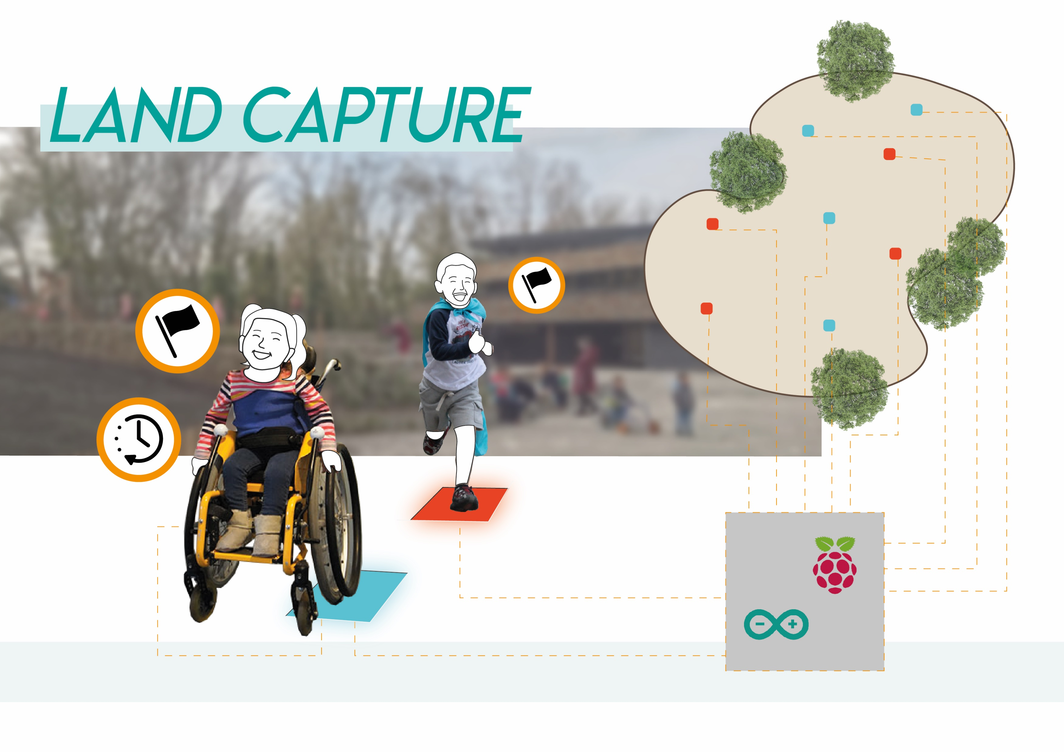

Slide 2
Product architecture prototype 1
TILE
Kid activates button
Button
- switch signal for the LED
LED
- Indicate status of the tile
Arduino
- keeps track of the status of the tile
- Sends status to the raspberry pi

Slide 3
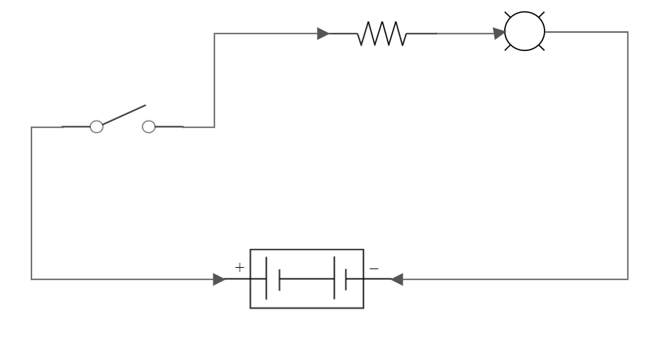
Electrical circuit

Slide 4
Actuators and Sensors
Function
Sensor type (prop.)
Pros
Cons
Change colour of the LED
Push button
On and off signal
Very simple option
Cheap
Can only give two signals as output
Indicate status of the tile
LED light
Multiple colours
Cheap
Not bright enough in sun light
Transmit data from Arduino to raspberry Pi
Bluetooth transmitter
Low energy consumption
More expensive than radio
Need to pair every tile
Close distance 10m
Transmit data from Arduino to raspberry Pi
RF transmitter
RFM69
Wide range of 500m
Cheap
Much power is used
Transmit data from tile (Arduino) to RaspberryPi
433 MHz Set
Transmitter and receiver
Cheap
Easy to assemble often used in other products
Amount of data is limited
Generate power for the tile
Solar panel
Charges during use
Unlimited amount of energy
Expensive
Not Robust
Power the tile when it is not charged
Battery
Small amount of energy is needed

Slide 5
Product architecture ideal situation
TILE
Kid activates button
Button
- Switch signal for the LED
- Should detect if wheelchair pushes the button or a kid
Raspberry Pi
Raspberry Pi
- process the data of the Arduino
LED
- Indicate status of the tile
433 MHz
- Sends data to Raspberry Pi
Score board
- show the score of the game
Arduino
- keeps track of the status of the tile
- Sends status to the raspberry pi
433 MHz
- sents data to Raspberry Pi

